Slide 2
PREVIEW OF CHAPTER
2
Intermediate Accounting
IFRS 2nd Edition
Kieso, Weygandt, and Warfield

Slide 3
LEARNING OBJECTIVES
2
Conceptual Framework
for Financial Reporting
After studying this chapter, you should be able to:
Describe the usefulness of a conceptual framework.
Describe efforts to construct a conceptual framework.
Understand the objective of financial reporting.
Identify the qualitative characteristics of accounting information.
Define the basic elements of financial statements.
Describe the basic assumptions of accounting.
Explain the application of the basic principles of accounting.
Describe the impact that the cost constraint has on reporting accounting information.

Slide 4
CONCEPTUAL FRAMEWORK
Conceptual Framework establishes the concepts that underlie financial reporting.
Need for a Conceptual Framework
Rule-making should build on and relate to an established body of concepts.
Enables IASB to issue more useful and consistent pronouncements over time.
LO 1

Slide 5
WHAT’S YOUR PRINCIPLE?
The need for a conceptual framework is highlighted by accounting scandals such as those at Royal Ahold (NLD), Enron (USA), and Satyan Computer Services (IND). To restore public confidence in the financial reporting process, many have argued that regulators should move toward principles-based rules. They believe that companies exploited the detailed provisions in rules-based pronouncements to manage accounting reports, rather than report the economic substance of transactions. For example, many of the off–balance-sheet arrangements of Enron avoided transparent reporting by barely achieving 3 percent outside equity ownership, a requirement in an obscure accounting rule interpretation. Enron’s financial engineers were able to structure transactions to achieve a desired accounting treatment, even if that accounting treatment did not reflect the transaction’s true nature. Under principles-based rules, hopefully top management’s financial reporting focus will shift from demonstrating compliance with rules to demonstrating that a company has attained financial reporting objectives.
LO 1

Slide 6
LEARNING OBJECTIVES
2
Conceptual Framework
for Financial Reporting
After studying this chapter, you should be able to:
Describe the usefulness of a conceptual framework.
Describe efforts to construct a conceptual framework.
Understand the objective of financial reporting.
Identify the qualitative characteristics of accounting information.
Define the basic elements of financial statements.
Describe the basic assumptions of accounting.
Explain the application of the basic principles of accounting.
Describe the impact that the cost constraint has on reporting accounting information.

Slide 7
CONCEPTUAL FRAMEWORK
Development of a Conceptual Framework
Presently, the Conceptual Framework is comprises of the following.
• Chapter 1: The Objective of General Purpose Financial Reporting
• Chapter 2: The Reporting Entity (not yet issued)
• Chapter 3: Qualitative Characteristics of Useful Financial Information
• Chapter 4: The Framework, comprised of the following:
Underlying assumption—the going concern assumption;
The elements of financial statements;
Recognition of the elements of financial statements;
Measurement of the elements of financial statements; and
Concepts of capital and capital maintenance.
LO 2

Slide 8
CONCEPTUAL FRAMEWORK
Overview of the Conceptual Framework
Three levels:
First Level = Objectives of Financial Reporting
Second Level = Qualitative Characteristics and Elements of Financial Statements
Third Level = Recognition, Measurement, and Disclosure Concepts.
LO 2

Slide 9
ASSUMPTIONS
Economic entity
Going concern
Monetary unit
Periodicity
Accrual
PRINCIPLES
Measurement
Revenue recognition
Expense recognition
Full disclosure
CONSTRAINTS
Cost
Third level
The "how"—
implementation
QUALITATIVE CHARACTERISTICS
Fundamental qualities
Enhancing qualities
ELEMENTS
Assets
Liabilities
Equity
Income
Expenses
Second level
Bridge between
levels 1 and 3
ILLUSTRATION 2-7 Conceptual Framework for Financial Reporting
OBJECTIVE
Provide information about the reporting
entity that is useful
to present and potential
equity investors,
lenders, and other
creditors in their
capacity as capital
providers.
First level
The "why"—purpose
of accounting

Slide 10
LEARNING OBJECTIVES
2
Conceptual Framework
for Financial Reporting
After studying this chapter, you should be able to:
Describe the usefulness of a conceptual framework.
Describe efforts to construct a conceptual framework.
Understand the objective of financial reporting.
Identify the qualitative characteristics of accounting information.
Define the basic elements of financial statements.
Describe the basic assumptions of accounting.
Explain the application of the basic principles of accounting.
Describe the impact that the cost constraint has on reporting accounting information.

Slide 11
FIRST LEVEL: BASIC OBJECTIVE
OBJECTIVE
“To provide financial information about the reporting entity that is useful to present and potential equity investors, lenders, and other creditors in making decisions about providing resources to the entity.
Provided by issuing general-purpose financial statements.
Assumption is that users need reasonable knowledge of business and financial accounting matters to understand the information.
LO 3

Slide 12
LEARNING OBJECTIVES
2
Conceptual Framework
for Financial Reporting
After studying this chapter, you should be able to:
Describe the usefulness of a conceptual framework.
Describe efforts to construct a conceptual framework.
Understand the objective of financial reporting.
Identify the qualitative characteristics of accounting information.
Define the basic elements of financial statements.
Describe the basic assumptions of accounting.
Explain the application of the basic principles of accounting.
Describe the impact that the cost constraint has on reporting accounting information.

Slide 13
SECOND LEVEL: FUNDAMENTAL CONCEPTS
Qualitative Characteristics of Accounting Information
IASB identified the Qualitative Characteristics of accounting information that distinguish better (more useful) information from inferior (less useful) information for decision-making purposes.
LO 4

Slide 14
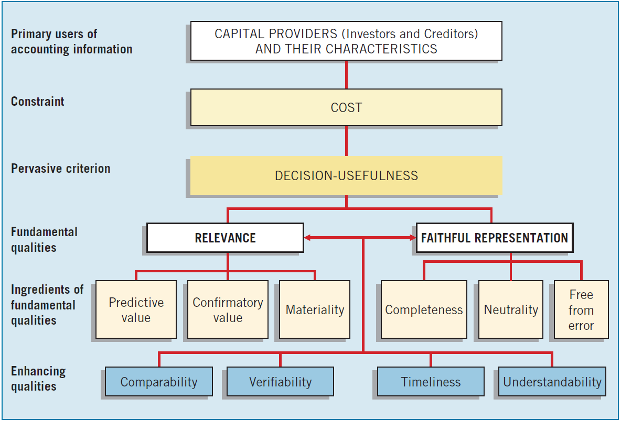
SECOND LEVEL: FUNDAMENTAL CONCEPTS
ILLUSTRATION 2-2 Hierarchy of Accounting Qualities
LO 4

Slide 15
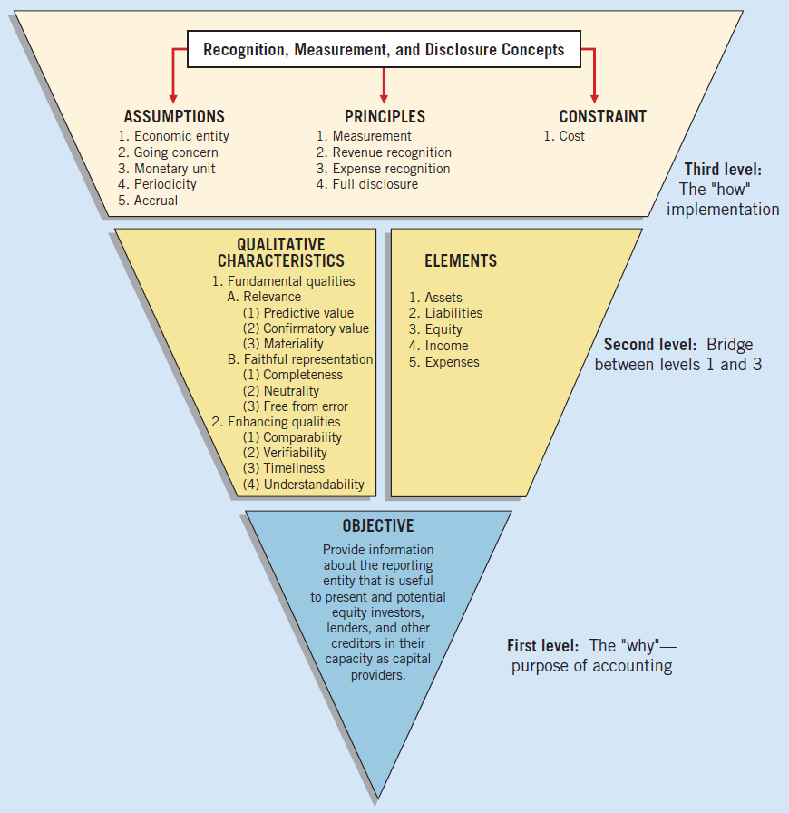
Relevance
ILLUSTRATION 2-7 Conceptual Framework for Financial Reporting
LO 4

Slide 16
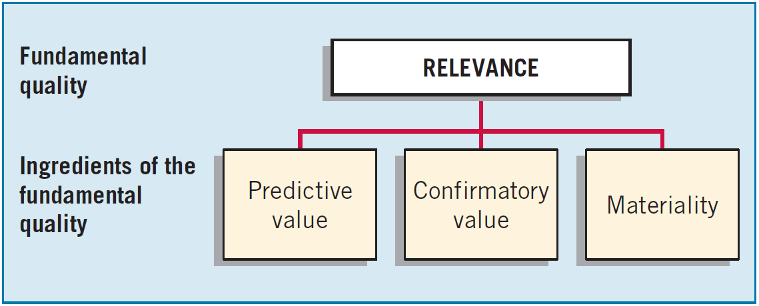
SECOND LEVEL: FUNDAMENTAL CONCEPTS
Fundamental Quality—Relevance
To be relevant, accounting information must be capable of making a difference in a decision.
LO 4

Slide 17
SECOND LEVEL: FUNDAMENTAL CONCEPTS
Fundamental Quality—Relevance
Financial information has predictive value if it has value as an input to predictive processes used by investors to form their own expectations about the future.
LO 4

Slide 18
SECOND LEVEL: FUNDAMENTAL CONCEPTS
Fundamental Quality—Relevance
Relevant information also helps users confirm or correct prior expectations.
LO 4

Slide 19
SECOND LEVEL: FUNDAMENTAL CONCEPTS
Fundamental Quality—Relevance
Information is material if omitting it or misstating it could influence decisions that users make on the basis of the reported financial information.
LO 4

Slide 20
Faithful Representation
ILLUSTRATION 2-7 Conceptual Framework for Financial Reporting
LO 4

Slide 21
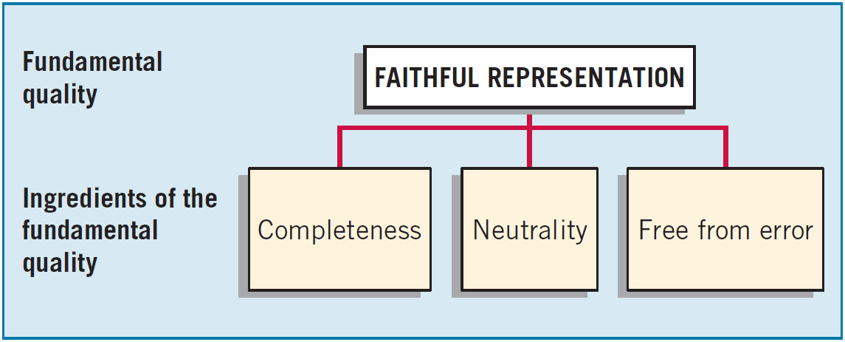
SECOND LEVEL: FUNDAMENTAL CONCEPTS
Fundamental Quality—Faithful Representation
Faithful representation means that the numbers and descriptions match what really existed or happened.
LO 4

Slide 22
SECOND LEVEL: FUNDAMENTAL CONCEPTS
Fundamental Quality—Faithful Representation
Completeness means that all the information that is necessary for faithful representation is provided.
LO 4

Slide 23
SECOND LEVEL: FUNDAMENTAL CONCEPTS
Fundamental Quality—Faithful Representation
Neutrality means that a company cannot select information to favor one set of interested parties over another.
LO 4

Slide 24
SECOND LEVEL: FUNDAMENTAL CONCEPTS
Fundamental Quality—Faithful Representation
An information item that is free from error will be a more accurate (faithful) representation of a financial item.
LO 4

Slide 25
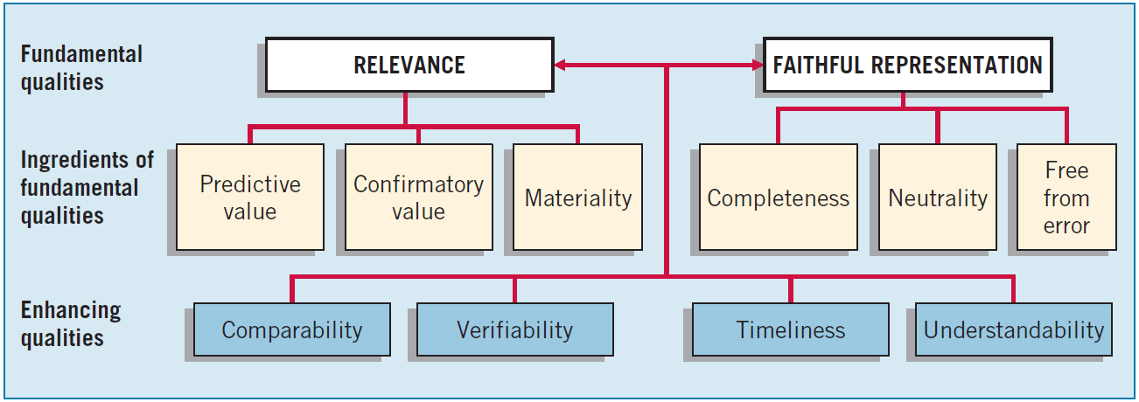
SECOND LEVEL: FUNDAMENTAL CONCEPTS
Enhancing Qualities
Information that is measured and reported in a similar manner for different companies is considered comparable.
LO 4

Slide 26
SECOND LEVEL: FUNDAMENTAL CONCEPTS
Enhancing Qualities
Verifiability occurs when independent measurers, using the same methods, obtain similar results.
LO 4

Slide 27
SECOND LEVEL: FUNDAMENTAL CONCEPTS
Enhancing Qualities
Timeliness means having information available to decision-makers before it loses its capacity to influence decisions.
LO 4

Slide 28
SECOND LEVEL: FUNDAMENTAL CONCEPTS
Enhancing Qualities
Understandability is the quality of information that lets reasonably informed users see its significance.
LO 4

Slide 29
LEARNING OBJECTIVES
2
Conceptual Framework
for Financial Reporting
After studying this chapter, you should be able to:
Describe the usefulness of a conceptual framework.
Describe efforts to construct a conceptual framework.
Understand the objective of financial reporting.
Identify the qualitative characteristics of accounting information.
Define the basic elements of financial statements.
Describe the basic assumptions of accounting.
Explain the application of the basic principles of accounting.
Describe the impact that the cost constraint has on reporting accounting information.

Slide 30
Basic Elements
ILLUSTRATION 2-7 Conceptual Framework for Financial Reporting
LO 5

Slide 31
SECOND LEVEL: BASIC ELEMENTS
Elements of Financial Statements
Asset
A resource controlled by the entity as a result of past events and from which future economic benefits are expected to flow to the entity.
Liability
Equity
Income
Expenses
LO 5
Notes:
Assets are economic resources that provide a future benefit for a business. Most firms use the following asset accounts:
Cash: money and any medium of exchange including bank account balances, paper currency, coins, certificates of deposit, and checks.
Accounts receivable: a company sells its goods and services and receives a promise for future collection of cash. The agreement to allow customers to pay in the future is informal and usually for a short period of time. The Accounts receivable account holds these amounts.
Notes receivable: a company may receive a note receivable from a customer, who signed the note promising to pay. A note receivable is similar to an account receivable, but a note receivable is more binding because the customer signed the note. Notes receivable usually specify an interest rate.

Slide 32
SECOND LEVEL: BASIC ELEMENTS
Elements of Financial Statements
Asset
A present obligation of the entity arising from past events, the settlement of which is expected to result in an outflow from the entity of resources embodying economic benefits.
Liability
Equity
Income
Expenses
LO 5
Notes:
Assets are economic resources that provide a future benefit for a business. Most firms use the following asset accounts:
Cash: money and any medium of exchange including bank account balances, paper currency, coins, certificates of deposit, and checks.
Accounts receivable: a company sells its goods and services and receives a promise for future collection of cash. The agreement to allow customers to pay in the future is informal and usually for a short period of time. The Accounts receivable account holds these amounts.
Notes receivable: a company may receive a note receivable from a customer, who signed the note promising to pay. A note receivable is similar to an account receivable, but a note receivable is more binding because the customer signed the note. Notes receivable usually specify an interest rate.

Slide 33
SECOND LEVEL: BASIC ELEMENTS
Elements of Financial Statements
Asset
Liability
Equity
The residual interest in the assets of the entity after deducting all its liabilities.
Income
Expenses
LO 5
Notes:
Assets are economic resources that provide a future benefit for a business. Most firms use the following asset accounts:
Cash: money and any medium of exchange including bank account balances, paper currency, coins, certificates of deposit, and checks.
Accounts receivable: a company sells its goods and services and receives a promise for future collection of cash. The agreement to allow customers to pay in the future is informal and usually for a short period of time. The Accounts receivable account holds these amounts.
Notes receivable: a company may receive a note receivable from a customer, who signed the note promising to pay. A note receivable is similar to an account receivable, but a note receivable is more binding because the customer signed the note. Notes receivable usually specify an interest rate.

Slide 34
SECOND LEVEL: BASIC ELEMENTS
Elements of Financial Statements
Asset
Liability
Equity
Increases in economic benefits during the accounting period in the form of inflows or enhancements of assets or decreases of liabilities that result in increases in equity, other than those relating to contributions from equity participants.
Income
Expenses
LO 5
Notes:
Assets are economic resources that provide a future benefit for a business. Most firms use the following asset accounts:
Cash: money and any medium of exchange including bank account balances, paper currency, coins, certificates of deposit, and checks.
Accounts receivable: a company sells its goods and services and receives a promise for future collection of cash. The agreement to allow customers to pay in the future is informal and usually for a short period of time. The Accounts receivable account holds these amounts.
Notes receivable: a company may receive a note receivable from a customer, who signed the note promising to pay. A note receivable is similar to an account receivable, but a note receivable is more binding because the customer signed the note. Notes receivable usually specify an interest rate.

Slide 35
SECOND LEVEL: BASIC ELEMENTS
Elements of Financial Statements
Asset
Liability
Equity
Decreases in economic benefits during the accounting period in the form of outflows or depletions of assets or incurrences of liabilities that result in decreases in equity, other than those relating to distributions to equity participants.
Income
Expenses
LO 5
Notes:
Assets are economic resources that provide a future benefit for a business. Most firms use the following asset accounts:
Cash: money and any medium of exchange including bank account balances, paper currency, coins, certificates of deposit, and checks.
Accounts receivable: a company sells its goods and services and receives a promise for future collection of cash. The agreement to allow customers to pay in the future is informal and usually for a short period of time. The Accounts receivable account holds these amounts.
Notes receivable: a company may receive a note receivable from a customer, who signed the note promising to pay. A note receivable is similar to an account receivable, but a note receivable is more binding because the customer signed the note. Notes receivable usually specify an interest rate.

Slide 36
SECOND LEVEL: BASIC ELEMENTS
Exercise 2-4: Identify the qualitative characteristic(s) to be used given the information provided.
Characteristics
Qualitative characteristic being displayed when companies in the same industry are using the same accounting principles.
Quality of information that confirms users’ earlier expectations.
Imperative for providing comparisons of a company from period to period.
Ignores the economic consequences of a standard or rule.
Relevance
Faithful representation
Predictive value
Confirmatory value
Neutrality
Materiality
Timeliness
Verifiability
Understandability
Comparability
LO 5

Slide 37
SECOND LEVEL: BASIC ELEMENTS
Exercise 2-4: Identify the qualitative characteristic(s) to be used given the information provided.
Characteristics
Requires a high degree of consensus among individuals on a given measurement.
Predictive value is an ingredient of this fundamental quality of information.
Four qualitative characteristics that enhance both relevance and faithful representation.
An item is not reported because its effect on income would not change a decision.
Relevance
Faithful representation
Predictive value
Confirmatory value
Neutrality
Materiality
Timeliness
Verifiability
Understandability
Comparability
LO 5

Slide 38
SECOND LEVEL: BASIC ELEMENTS
Exercise 2-4: Identify the qualitative characteristic(s) to be used given the information provided.
Characteristics
Neutrality is a key ingredient of this fundamental quality of accounting information.
Two fundamental qualities that make accounting information useful for decision-making purposes.
Issuance of interim reports is an example of what enhancing ingredient?
Relevance
Faithful representation
Predictive value
Confirmatory value
Neutrality
Materiality
Timeliness
Verifiability
Understandability
Comparability
LO 5

Slide 39
LEARNING OBJECTIVES
2
Conceptual Framework
for Financial Reporting
After studying this chapter, you should be able to:
Describe the usefulness of a conceptual framework.
Describe efforts to construct a conceptual framework.
Understand the objective of financial reporting.
Identify the qualitative characteristics of accounting information.
Define the basic elements of financial statements.
Describe the basic assumptions of accounting.
Explain the application of the basic principles of accounting.
Describe the impact that the cost constraint has on reporting accounting information.

Slide 40
THIRD LEVEL: RECOGNITION, MEASUREMENT, AND DISCLOSURE CONCEPTS
These concepts explain how companies should recognize, measure, and report financial elements and events.
Recognition, Measurement, and Disclosure Concepts
ASSUMPTIONS
Economic entity
Going concern
Monetary unit
Periodicity
Accrual
PRINCIPLES
Measurement
Revenue recognition
Expense recognition
Full disclosure
CONSTRAINTS
Cost
ILLUSTRATION 2-7 Conceptual Framework for Financial Reporting
LO 6

Slide 41
THIRD LEVEL: ASSUMPTIONS
Basic Assumptions
Economic Entity – company keeps its activity separate from its owners and other business unit.
Going Concern - company to last long enough to fulfill objectives and commitments.
Monetary Unit - money is the common denominator.
Periodicity - company can divide its economic activities into time periods.
Accrual Basis of Accounting – transactions are recorded in the periods in which the events occur.
LO 6

Slide 42
THIRD LEVEL: ASSUMPTIONS
BE2-8: Identify which basic assumption of accounting is best described in each item below.
The economic activities of FedEx Corporation (USA) are divided into 12-month periods for the purpose of issuing annual reports.
Total S.A. (FRA) does not adjust amounts in its financial statements for the effects of inflation.
Barclays (GBR) reports current and non-current classifications in its statement of financial position.
The economic activities of Tokai Rubber Industries (JPN) and its subsidiaries are merged for accounting and reporting purposes.
Periodicity
Monetary
Unit
Going Concern
Economic
Entity
LO 6

Slide 43
LEARNING OBJECTIVES
2
Conceptual Framework
for Financial Reporting
After studying this chapter, you should be able to:
Describe the usefulness of a conceptual framework.
Describe efforts to construct a conceptual framework.
Understand the objective of financial reporting.
Identify the qualitative characteristics of accounting information.
Define the basic elements of financial statements.
Describe the basic assumptions of accounting.
Explain the application of the basic principles of accounting.
Describe the impact that the cost constraint has on reporting accounting information.

Slide 44
THIRD LEVEL: BASIC PRINCIPLES
Measurement Principles
Historical Cost is generally thought to be a faithful representation of the amount paid for a given item.
Fair value is defined as “the price that would be received to sell an asset or paid to transfer a liability in an orderly transaction between market participants at the measurement date.”
IASB has given companies the option to use fair value as the basis for measurement of financial assets and financial liabilities.
LO 7

Slide 45
THIRD LEVEL: BASIC PRINCIPLES
Measurement Principles
IASB established a fair value hierarchy that provides insight into the priority of valuation techniques to use to determine fair value.
ILLUSTRATION 2-4
LO 7

Slide 46
THIRD LEVEL: BASIC PRINCIPLES
Revenue Recognition
When a company agrees to perform a service or sell a product to a customer, it has a performance obligation.
Requires that companies recognize revenue in the accounting period in which the performance obligation is satisfied.
LO 7

Slide 47
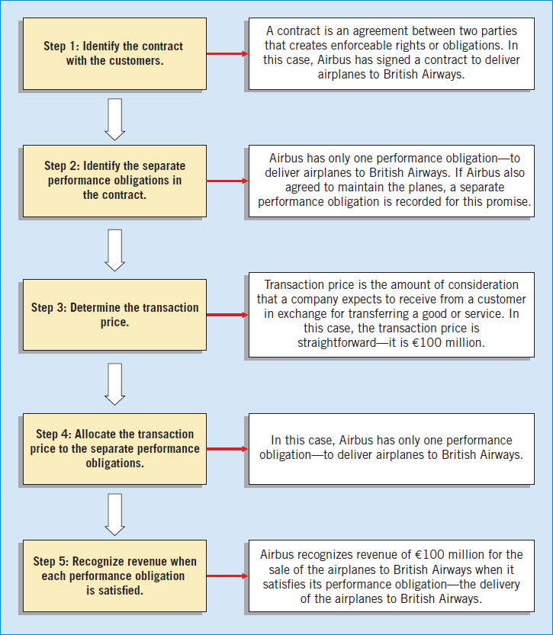
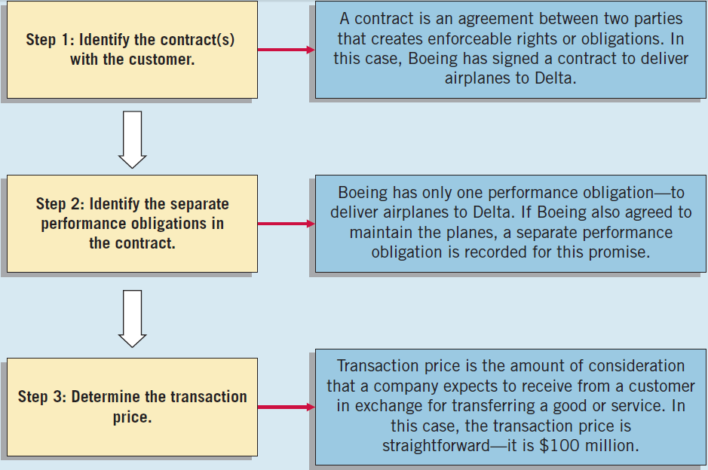
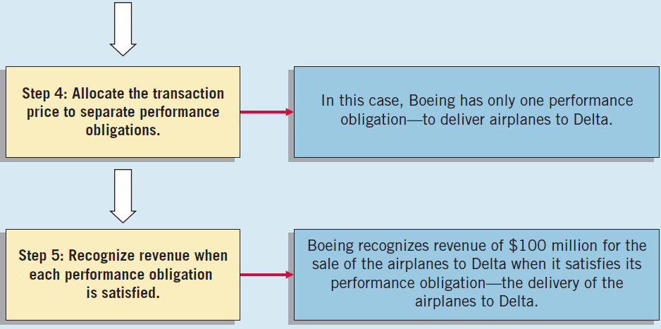
THIRD LEVEL: BASIC PRINCIPLES
Illustration: Assume the Airbus (DEU) signs a contract to sell airplanes to British Airways (GRB) for €100 million. To determine when to recognize revenue, Airbus uses the five steps for revenue recognition shown at right.
ILLUSTRATION 2-5
The Five Steps of Revenue Recognition

Slide 48
THIRD LEVEL: BASIC PRINCIPLES
Expense Recognition - Outflows or “using up” of assets or incurring of liabilities during a period as a result of delivering or producing goods and/or rendering services.
ILLUSTRATION 2-6 Expense Recognition
“Let the expense follow the revenues.”
LO 7

Slide 49
THIRD LEVEL: BASIC PRINCIPLES
Full Disclosure
Providing information that is of sufficient importance to influence the judgment and decisions of an informed user.
Provided through:
Financial Statements
Notes to the Financial Statements
Supplementary information
LO 7

Slide 50
THIRD LEVEL: BASIC PRINCIPLES
BE2-9: Identify which basic principle of accounting is best described in each item below.
(a) Parmalat (ITA) reports revenue in its income statement when it delivered goods instead of when the cash is collected.
(b) Google (USA) recognizes depreciation expense for a machine over the 2-year period during which that machine helps the company earn revenue.
(c) KC Corp. (USA) reports information about pending lawsuits in the notes to its financial statements.
(d) Fuji Film (JPN) reports land on its statement of financial position at the amount paid to acquire it, even though the estimated fair market value is greater.
Revenue
Recognition
Expense
Recognition
Full
Disclosure
Measurement
LO 7

Slide 51
LEARNING OBJECTIVES
2
Conceptual Framework
for Financial Reporting
After studying this chapter, you should be able to:
Describe the usefulness of a conceptual framework.
Describe efforts to construct a conceptual framework.
Understand the objective of financial reporting.
Identify the qualitative characteristics of accounting information.
Define the basic elements of financial statements.
Describe the basic assumptions of accounting.
Explain the application of the basic principles of accounting.
Describe the impact that the cost constraint has on reporting accounting information.

Slide 52
THIRD LEVEL: COST CONSTRAINT
Cost Constraint
Companies must weigh the costs of providing the information against the benefits that can be derived from using it.
Rule-making bodies and governmental agencies use cost-benefit analysis before making final their informational requirements.
In order to justify requiring a particular measurement or disclosure, the benefits perceived to be derived from it must exceed the costs perceived to be associated with it.
LO 8

Slide 53
THIRD LEVEL: COST CONSTRAINT
BE2-11: Determine whether you would classify these transactions as material.
In the current year, Blair Co. reduces its bad debt expense to ensure another positive earnings year. The impact of this adjustment is equal to 3% of net income.
Damon Co. expenses all capital equipment under €2,500 on the basis that it is immaterial. The company has followed this practice for a number of years.
Material
Likely not material
LO 8

Slide 54
Summary of the Structure
ILLUSTRATION 2-7 Conceptual Framework for Financial Reporting
LO 8

Slide 55
GLOBAL ACCOUNTING INSIGHTS
THE CONCEPTUAL FRAMEWORK
The IASB and the FASB have been working together to develop a common conceptual framework. This framework is based on the existing conceptual frameworks underlying U.S. GAAP and IFRS. The objective of this joint project is to develop a conceptual framework consisting of standards that are principles-based and internally consistent, thereby leading to the most useful financial reporting.

Slide 56
GLOBAL ACCOUNTING INSIGHTS
Relevant Facts
Following are the key similarities and differences between U.S. GAAP and IFRS related to the Conceptual Framework for Financial Reporting.
Similarities
In 2010, the IASB and FASB completed the first phase of a jointly created conceptual framework. In this first phase, they agreed on the objective of financial reporting and a common set of desired qualitative characteristics. These were presented in the Chapter 2 discussion. Note that prior to this converged phase, the Conceptual Framework gave more emphasis to the objective of providing information on management’s performance (stewardship).

Slide 57
GLOBAL ACCOUNTING INSIGHTS
Relevant Facts
Similarities
The existing conceptual frameworks underlying U.S. GAAP and IFRS are very similar. That is, they are organized in a similar manner (objective, elements, qualitative characteristics, etc.). There is no real need to change many aspects of the existing frameworks other than to converge different ways of discussing essentially the same concepts.
The converged framework should be a single document, unlike the two conceptual frameworks that presently exist. It is unlikely that the basic structure related to the concepts will change.

Slide 58
GLOBAL ACCOUNTING INSIGHTS
Relevant Facts
Similarities
Both the IASB and FASB have similar measurement principles, based on historical cost and fair value. In 2011, the Boards issued a converged standard on fair value measurement so that the definition of fair value, measurement techniques, and disclosures are the same between U.S. GAAP and IFRS when fair value is used in financial statements.
Differences
Although both U.S. GAAP and IFRS are increasing the use of fair value to report assets, at this point IFRS has adopted it more broadly. As examples, under IFRS, companies can apply fair value to property, plant, and equipment; natural resources; and, in some cases, intangible assets.

Slide 59
GLOBAL ACCOUNTING INSIGHTS
Relevant Facts
Differences
U.S. GAAP has a concept statement to guide estimation of fair values when market-related data is not available (Statement of Financial Accounting Concepts No. 7, “Using Cash Flow Information and Present Value in Accounting”). The IASB has not issued a similar concept statement; it has issued a fair value standard (IFRS 13) that is converged with U.S. GAAP.
The monetary unit assumption is part of each framework. However, the unit of measure will vary depending on the currency used in the country in which the company is incorporated (e.g., Chinese yuan, Japanese yen, and British pound).

Slide 60
GLOBAL ACCOUNTING INSIGHTS
Relevant Facts
Differences
The economic entity assumption is also part of each framework although some cultural differences result in differences in its application. For example, in Japan many companies have formed alliances that are so strong that they act similar to related corporate divisions although they are not actually part of the same company.

Slide 61
GLOBAL ACCOUNTING INSIGHTS
About The Numbers
While the conceptual framework that underlies U.S. GAAP is very similar to that used to develop IFRS, the elements identified and their definitions under U.S. GAAP are different.

Slide 62
GLOBAL ACCOUNTING INSIGHTS
On the Horizon
The IASB and the FASB face a difficult task in attempting to update, modify, and complete a converged conceptual framework. There are many challenging issues to overcome. For example, how do we trade off characteristics such as highly relevant information that is difficult to verify? How do we define control when we are developing a definition of an asset? Is a liability the future sacrifice itself or the obligation to make the sacrifice? Should a single measurement method, such as historical cost or fair value, be used, or does it depend on whether it is an asset or liability that is being measured? We are optimistic that the new converged conceptual framework will be a significant improvement over its predecessors and will lead to standards that will help financial statement users to make better decisions.

Slide 63
COPYRIGHT
Copyright © 2014 John Wiley & Sons, Inc. All rights reserved. Reproduction or translation of this work beyond that permitted in Section 117 of the 1976 United States Copyright Act without the express written permission of the copyright owner is unlawful. Request for further information should be addressed to the Permissions Department, John Wiley & Sons, Inc. The purchaser may make back-up copies for his/her own use only and not for distribution or resale. The Publisher assumes no responsibility for errors, omissions, or damages, caused by the use of these programs or from the use of the information contained herein.

